Slide 2
Guangya School Dujiangyan, Sichuan, China
http://www.escapefromamerica.com/2010/06/working-overseas-in-china-guangya-international-school/
Article about the history of the school

Slide 3
2016 Program Participants from Xuanhan

Slide 4
Purpose:
A two week immersion program exploring:
Cross cultural similarities and differences between America and China
Integration of art, music, games, and video into educational instruction
Exploration of American culture and language through “Movie” nights
“The Ultimate Gift” and “Gifted Hands”
Improvement in vocabulary, grammar, and pronunciation
Experimentation and practice with various teaching methods
Enrichment activities
Team building, Art, Guitar, Dance
2008 Earthquake Memorial Museum
Panda Breeding Research Center
Historic Dujiangyan water project
Qingcheng Mountain
So much to do and so little time!

Slide 5
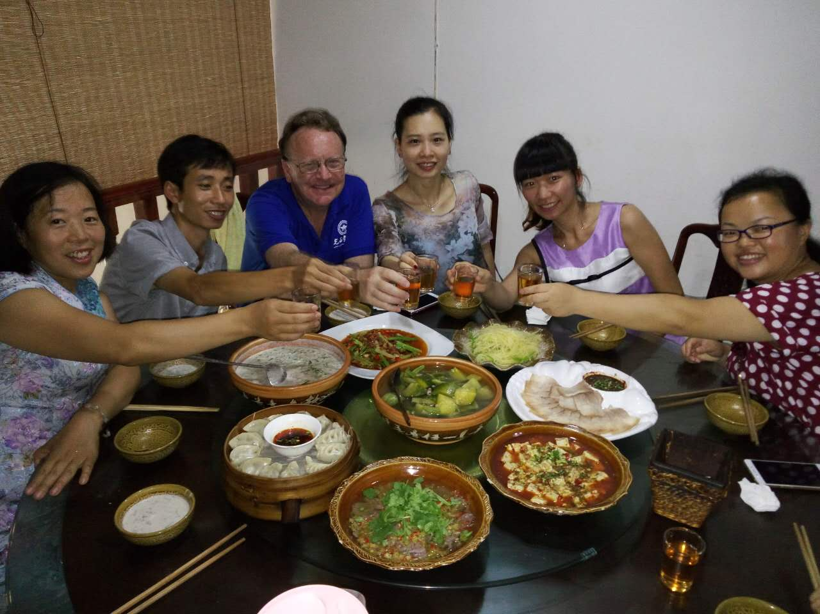
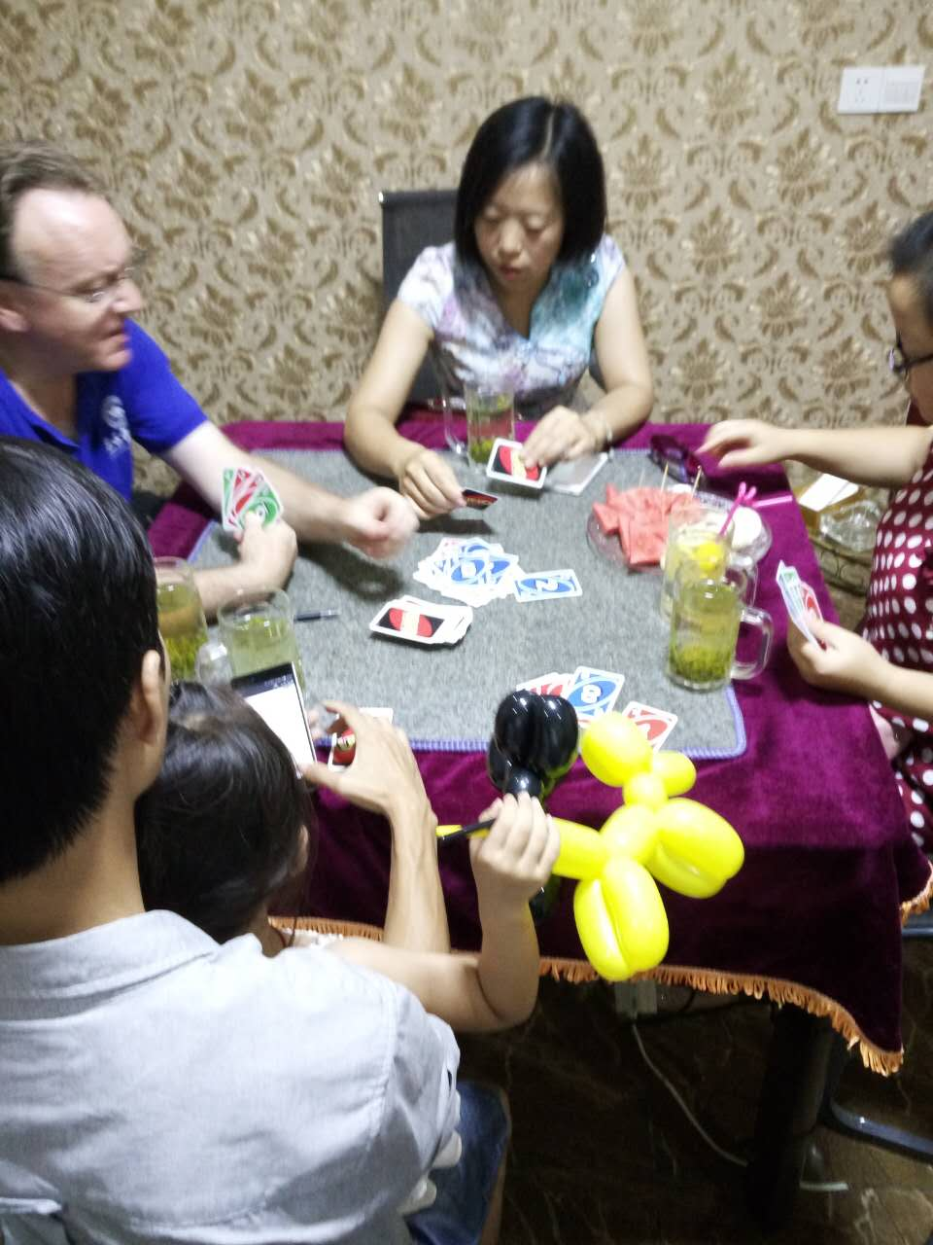
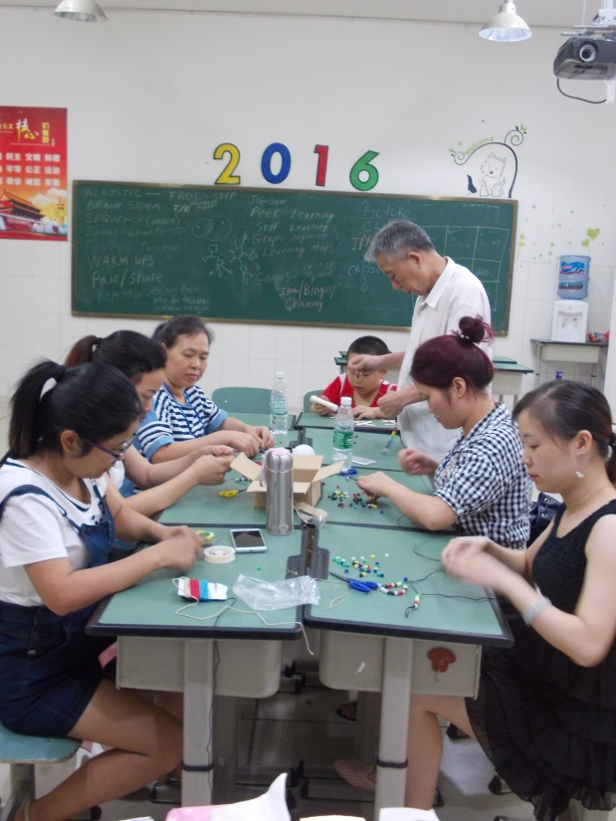
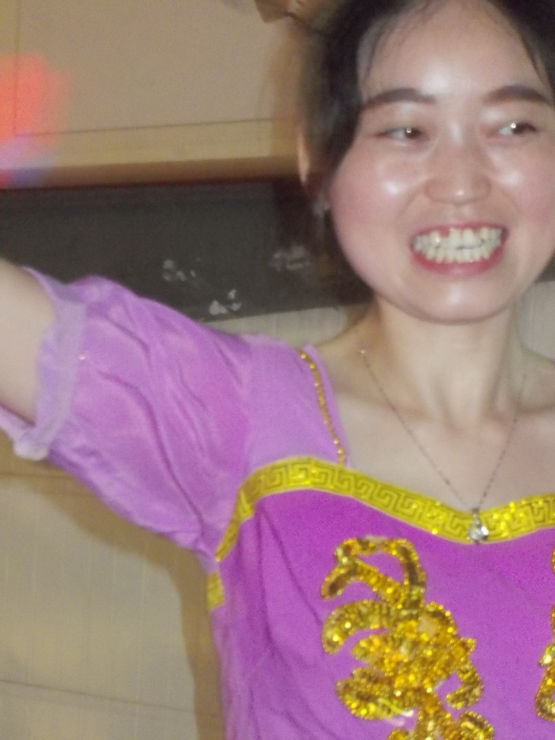
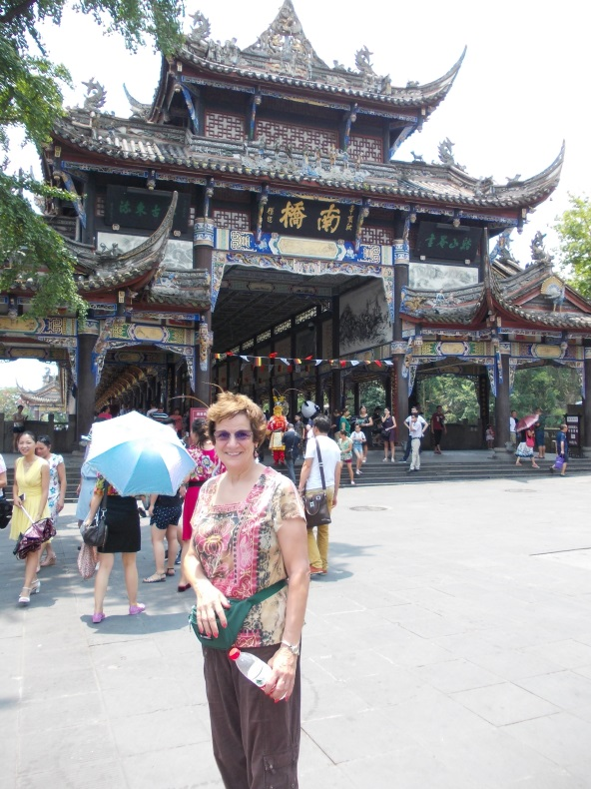
Sharing, Playing, Exploring, Learning, Loving

Slide 6
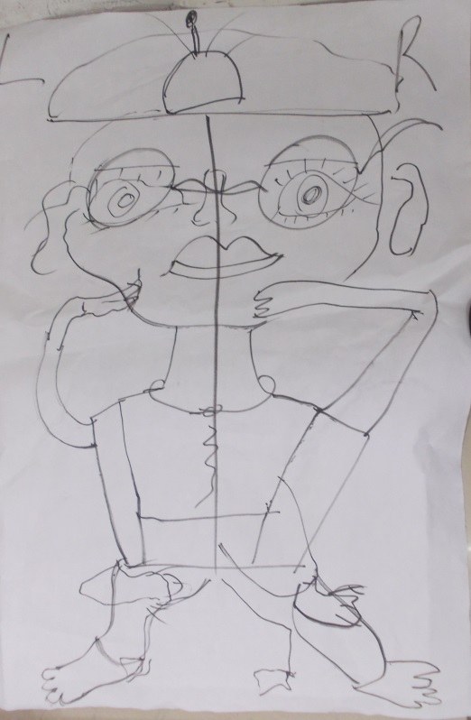
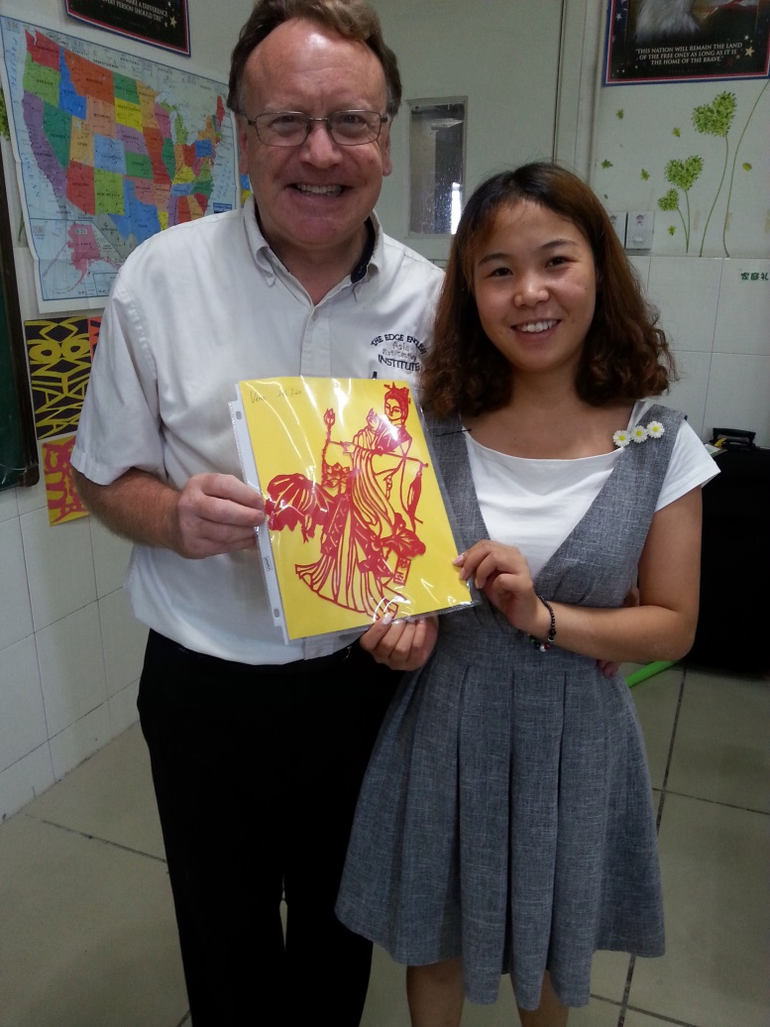
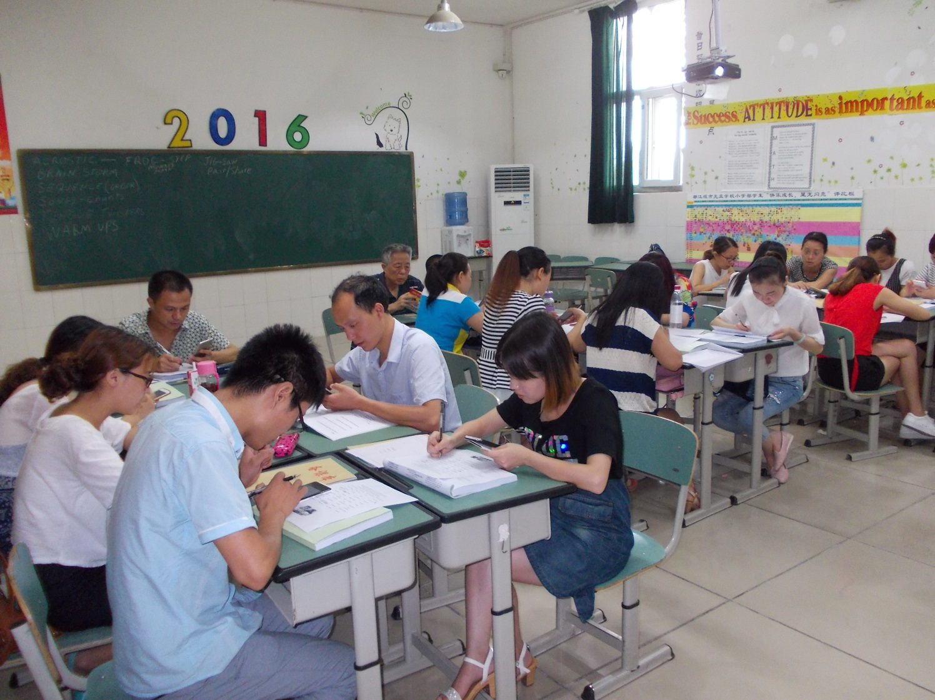
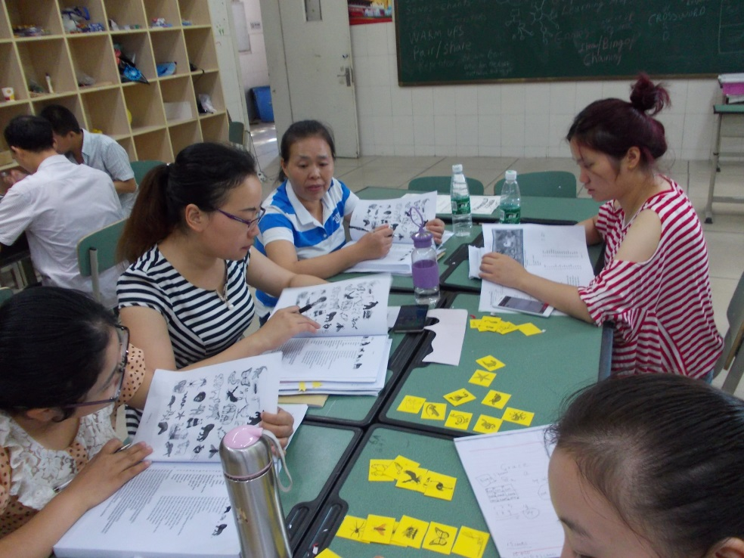
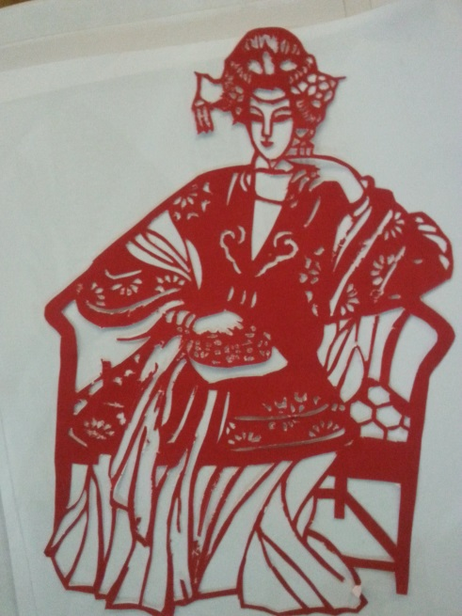

Slide 7
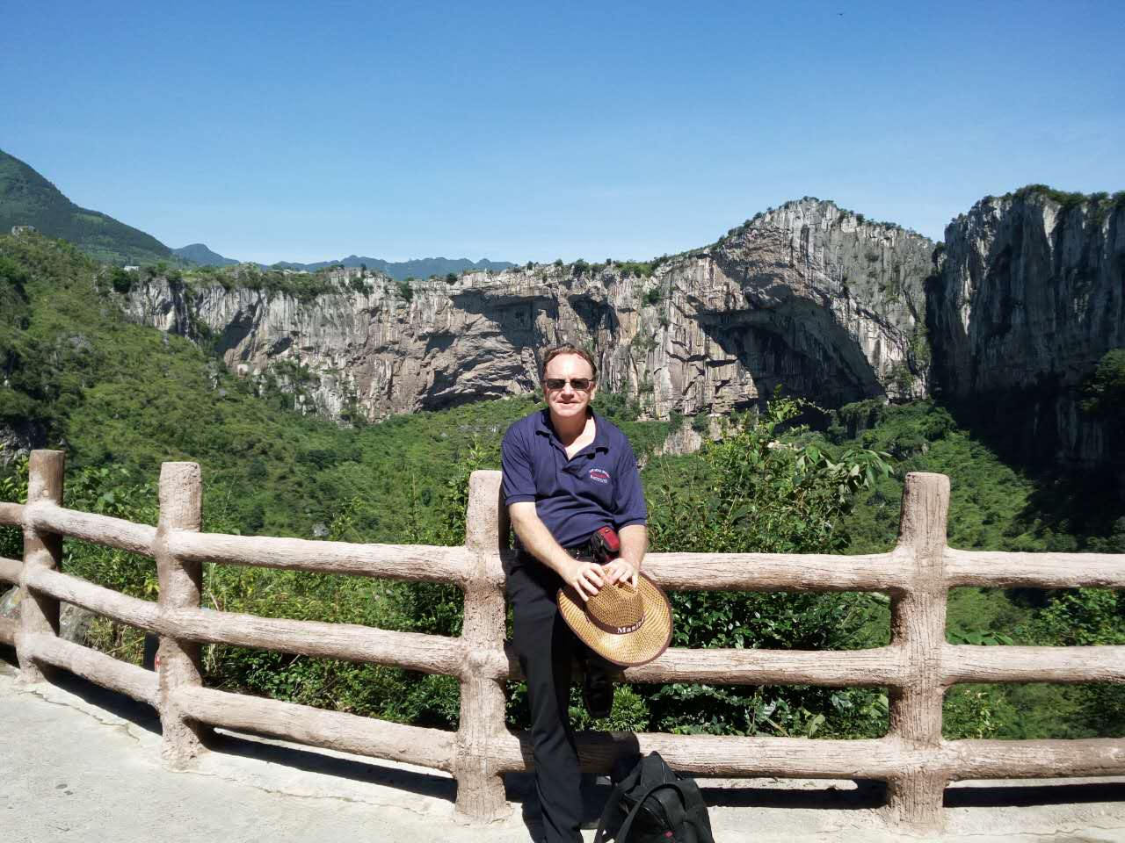
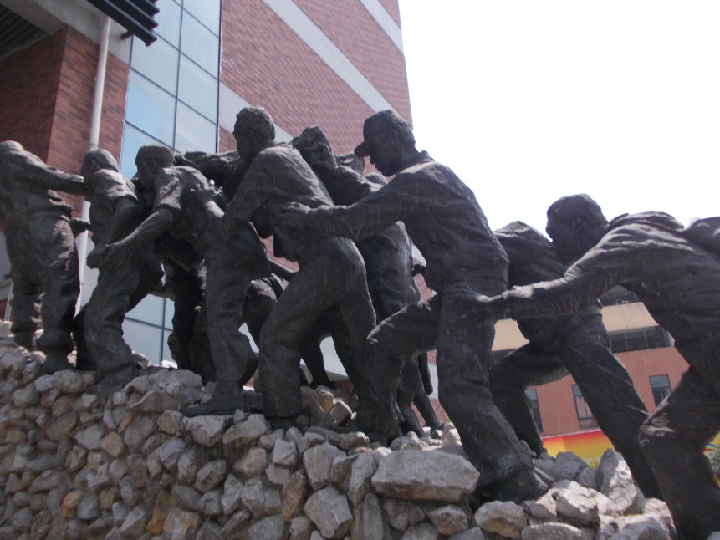
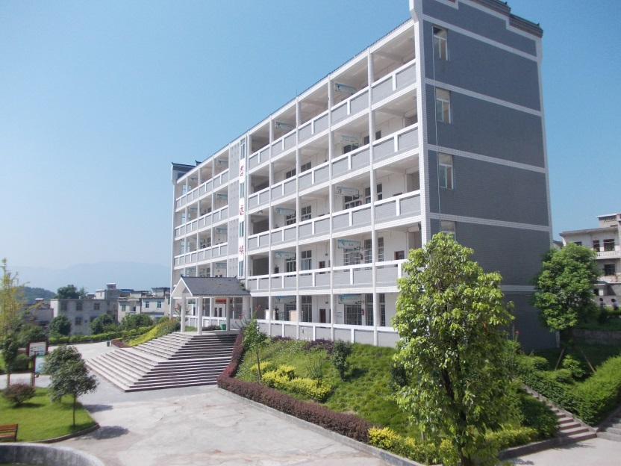
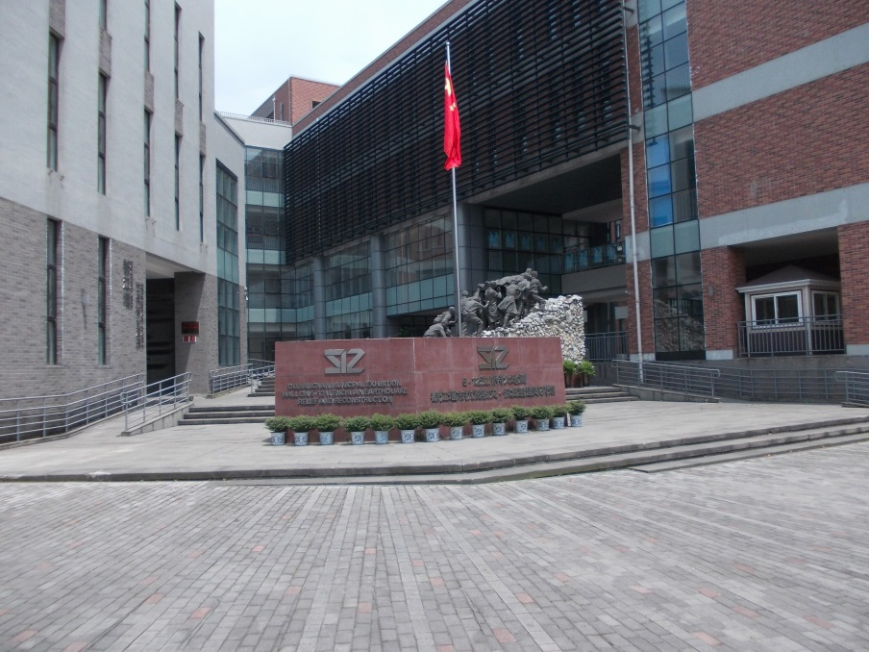
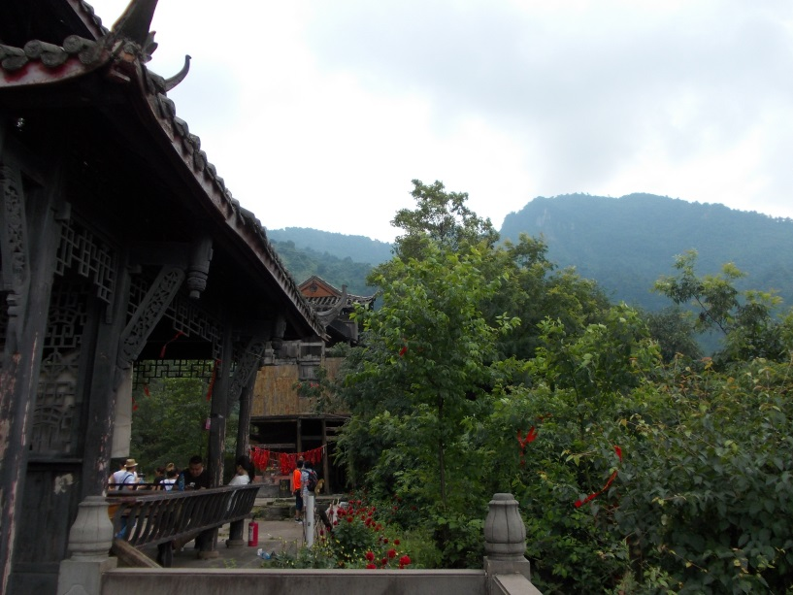

Slide 8
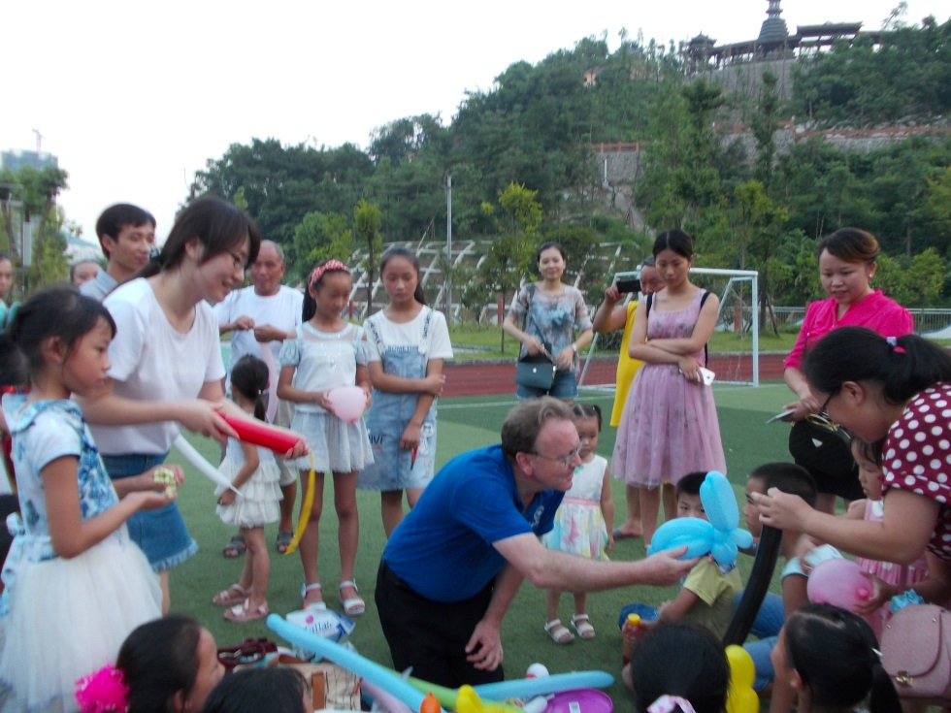
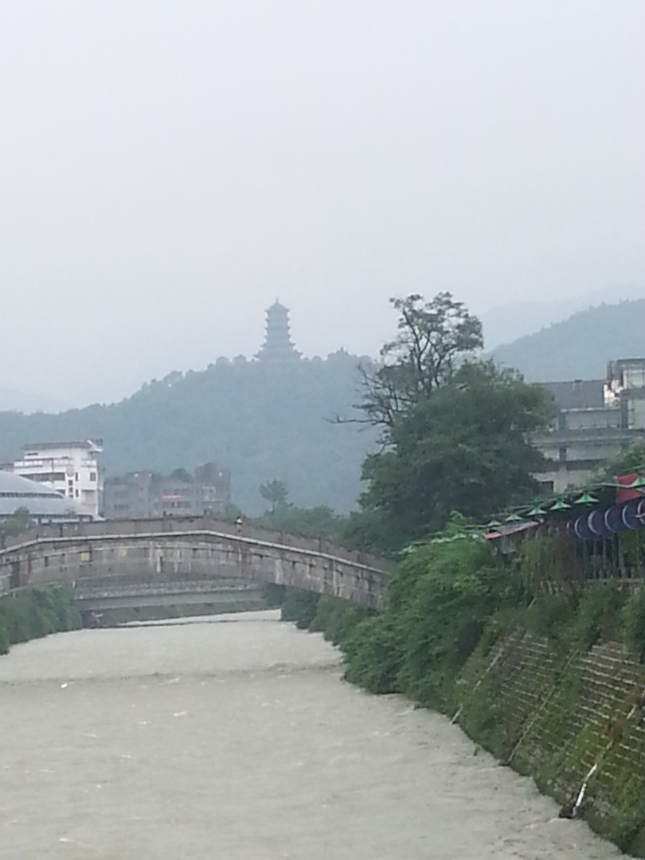
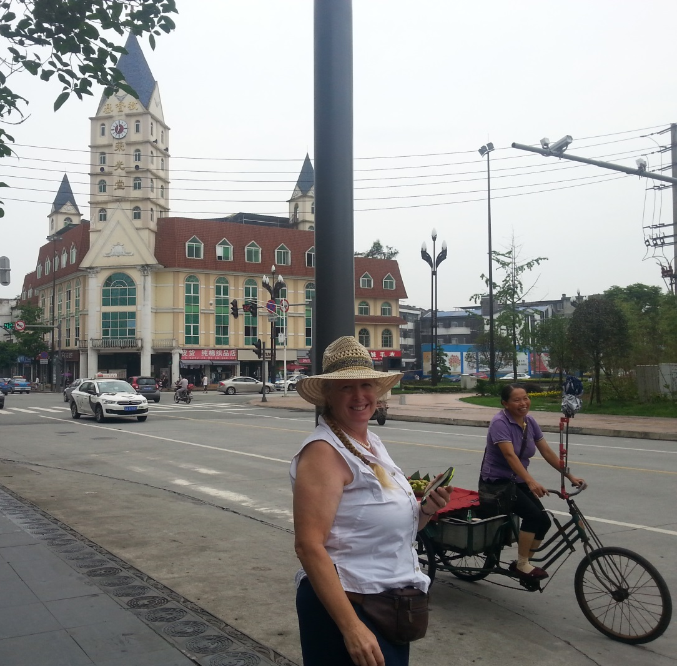
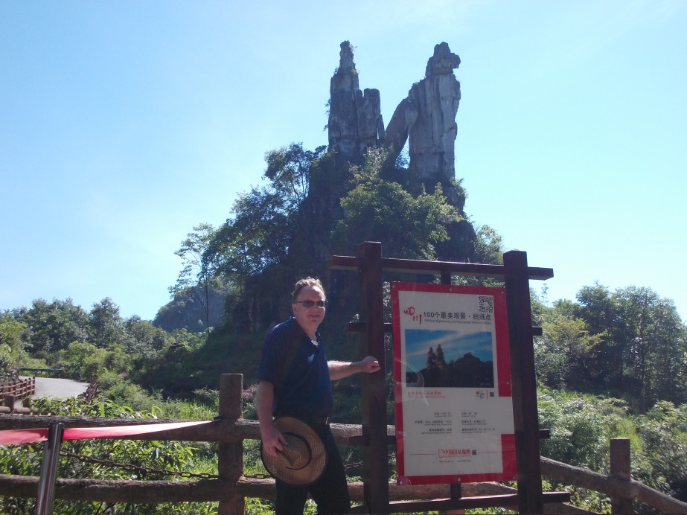
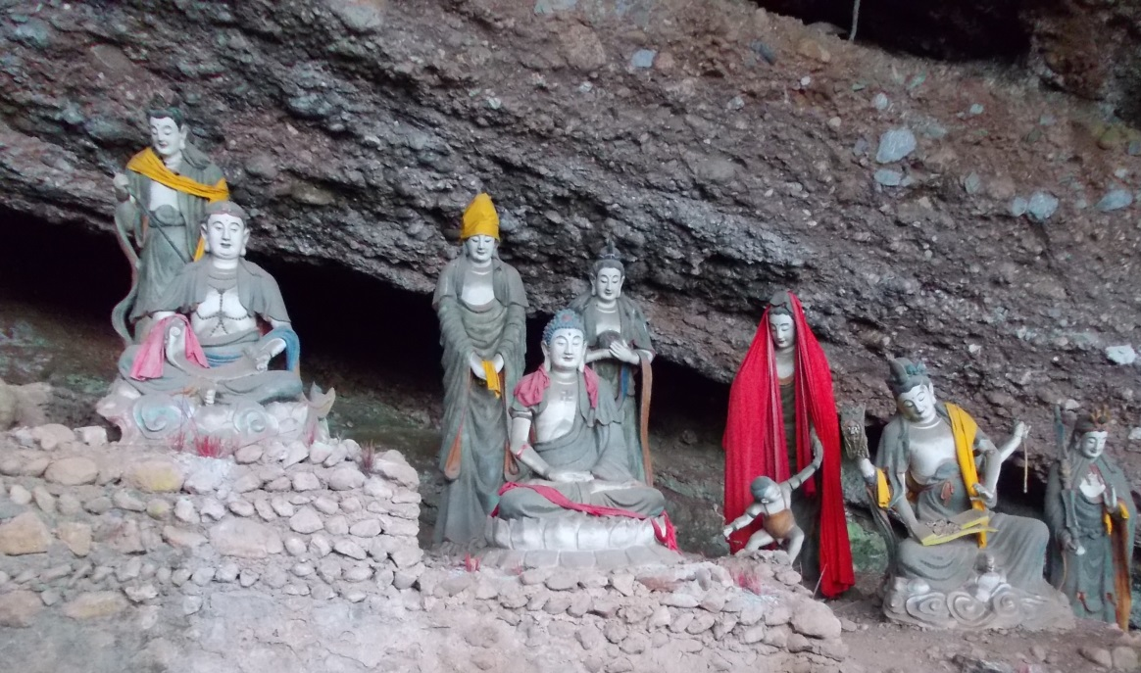

Slide 9
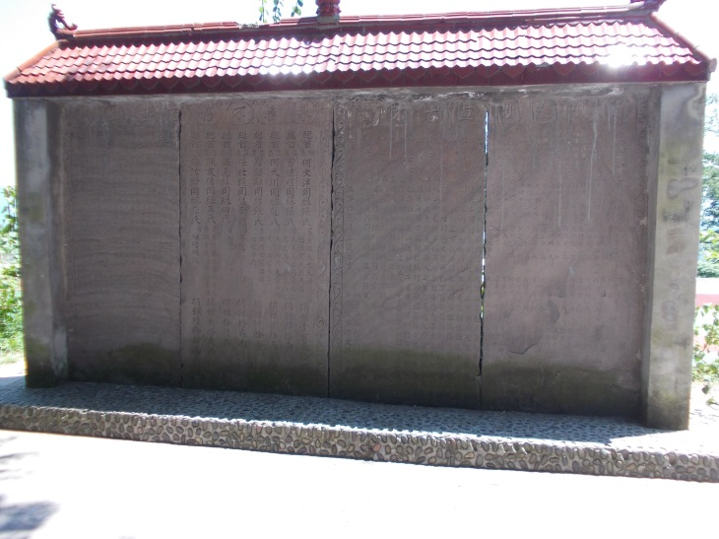
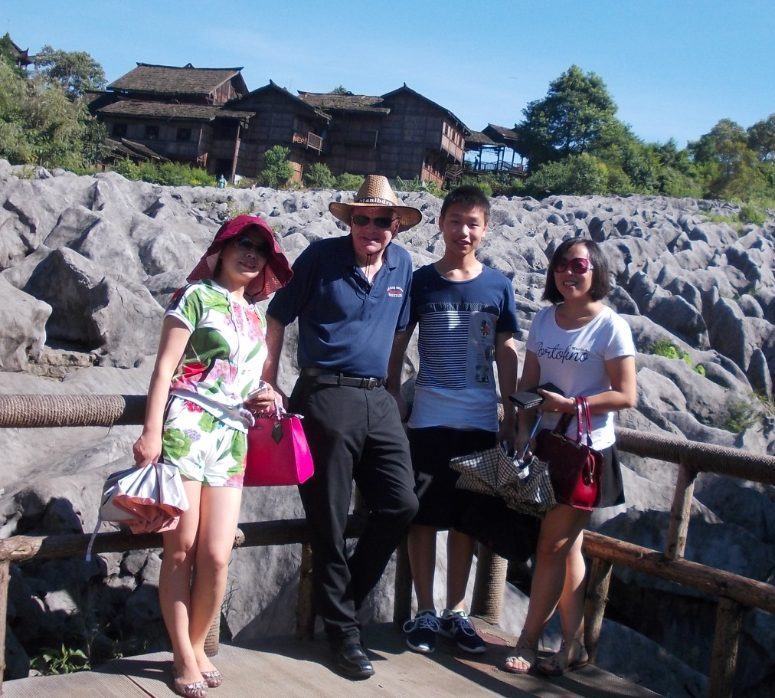
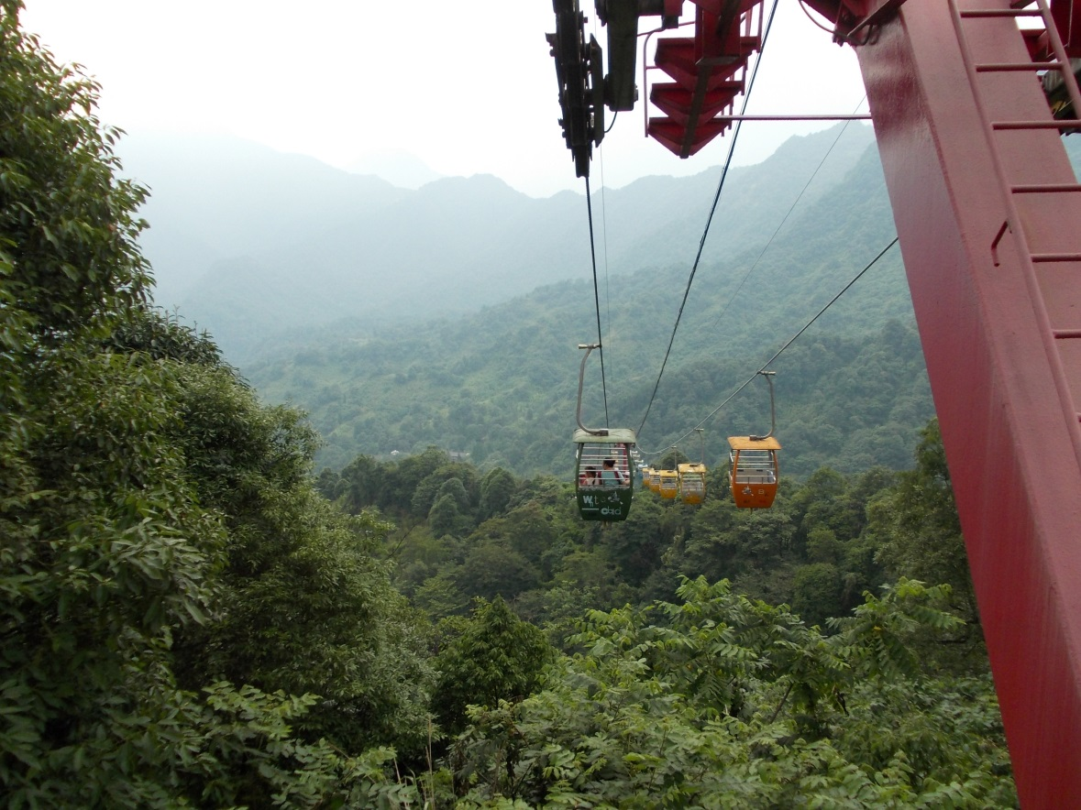
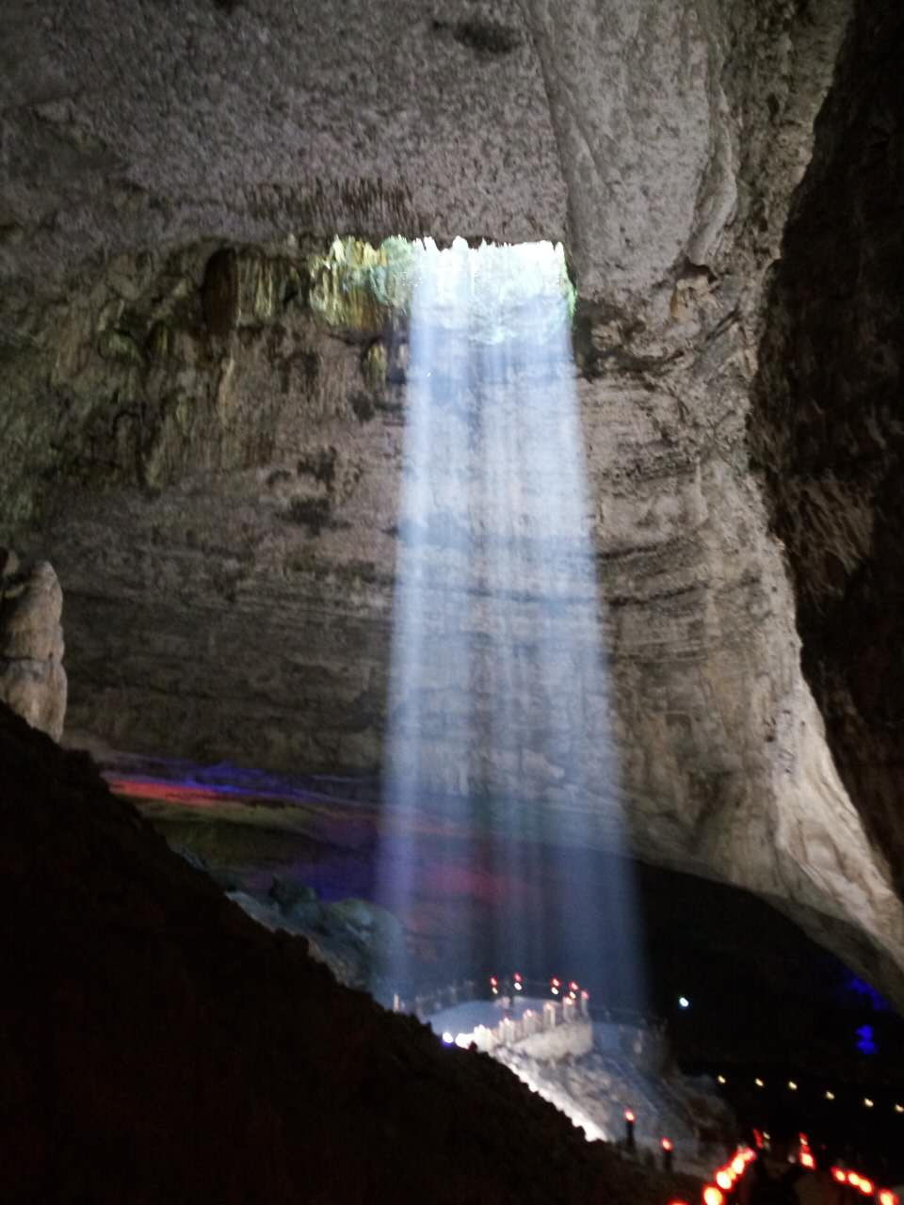
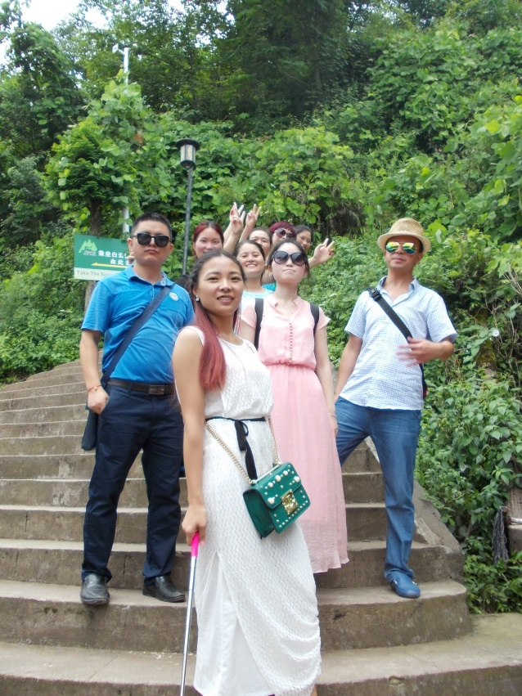
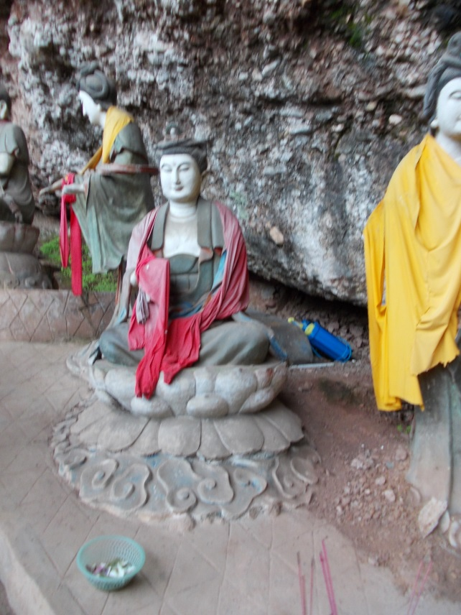
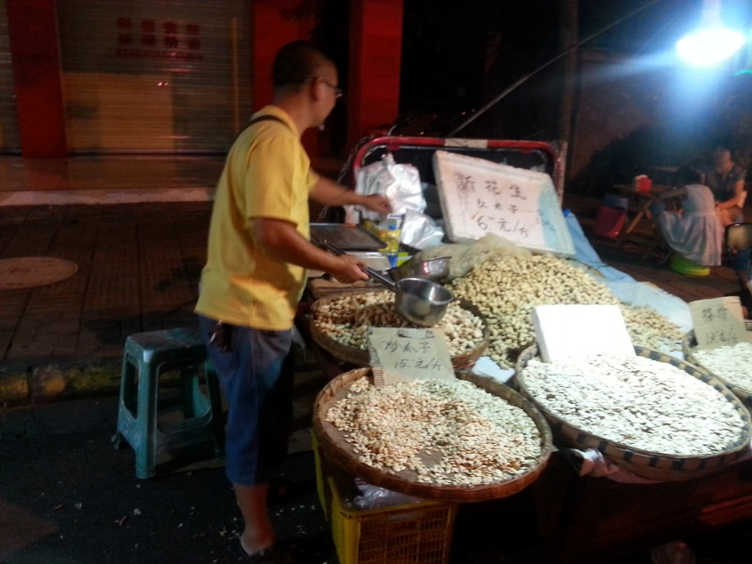

Slide 10
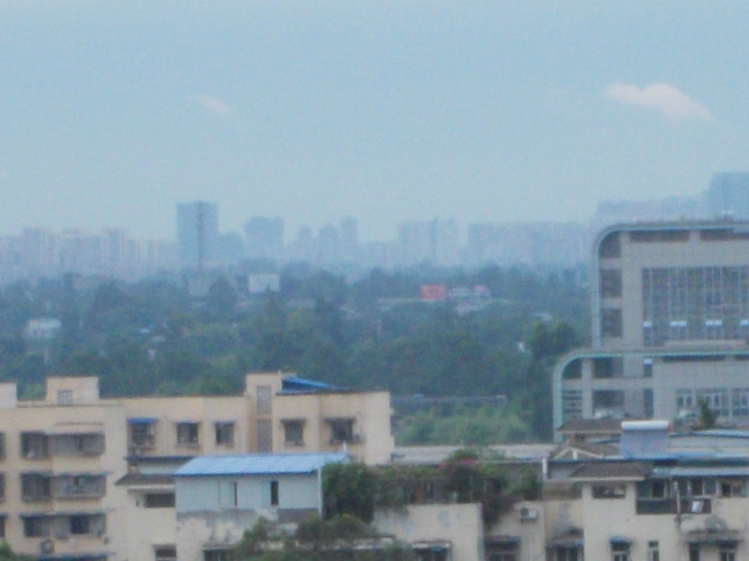
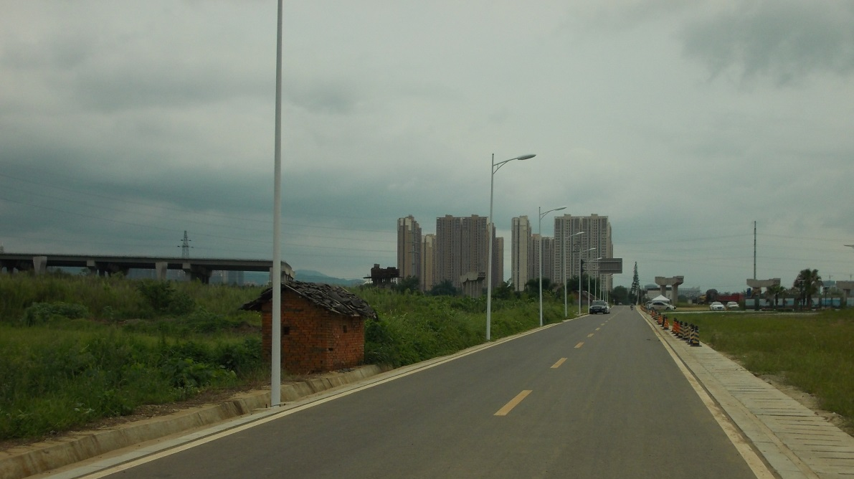
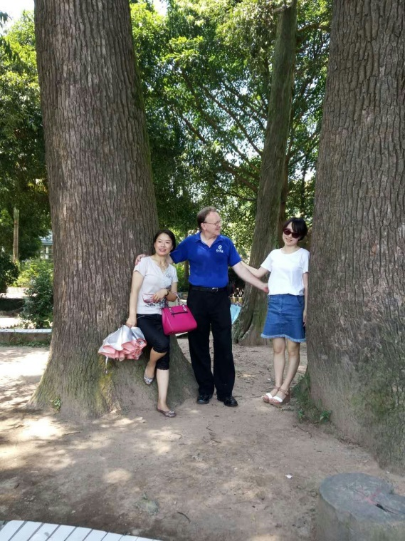
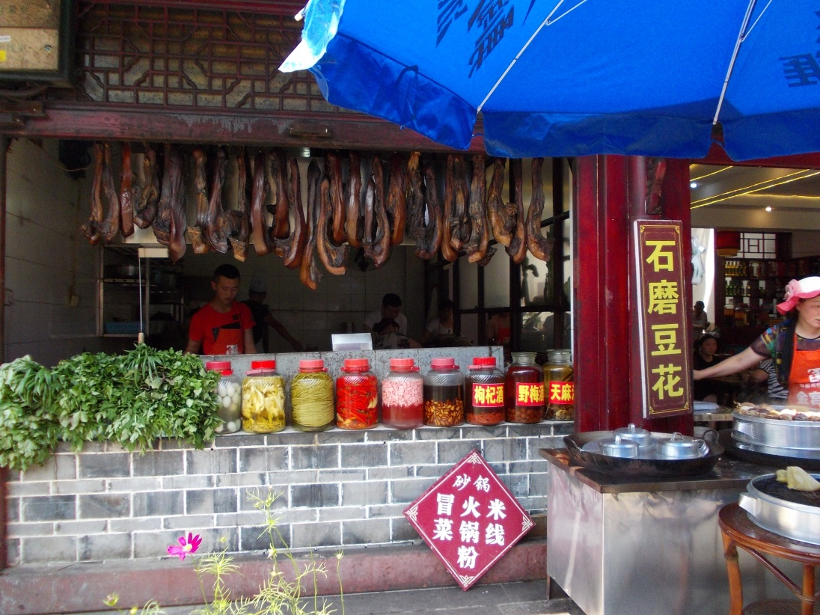
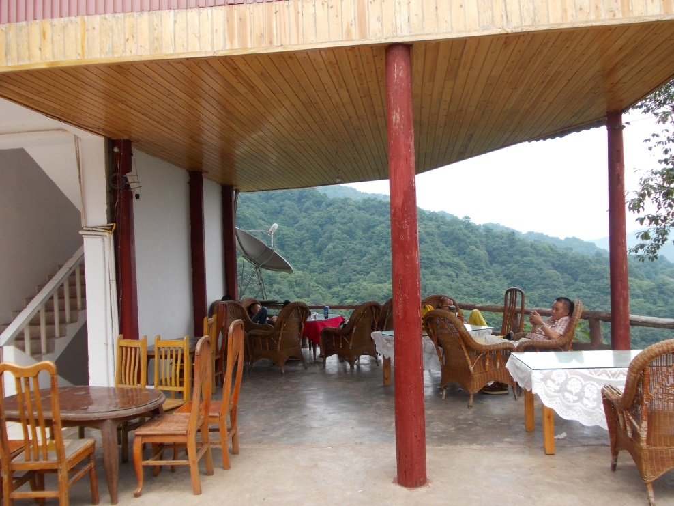
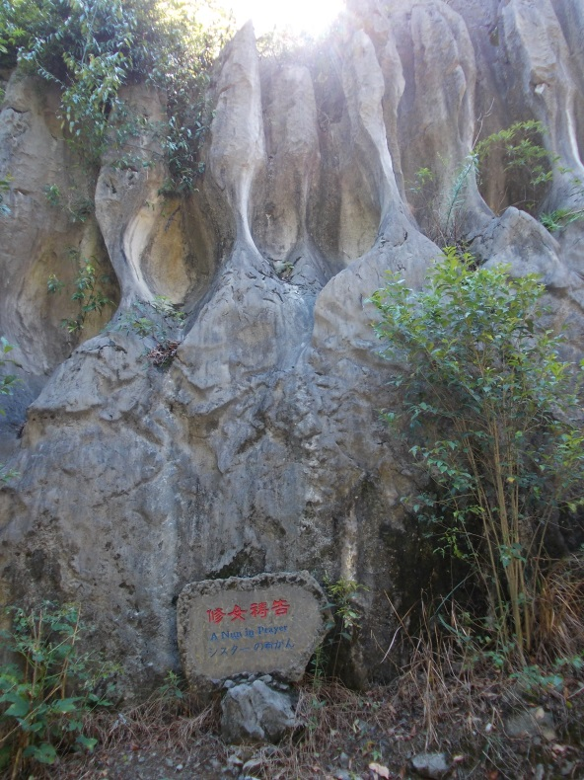

Slide 11
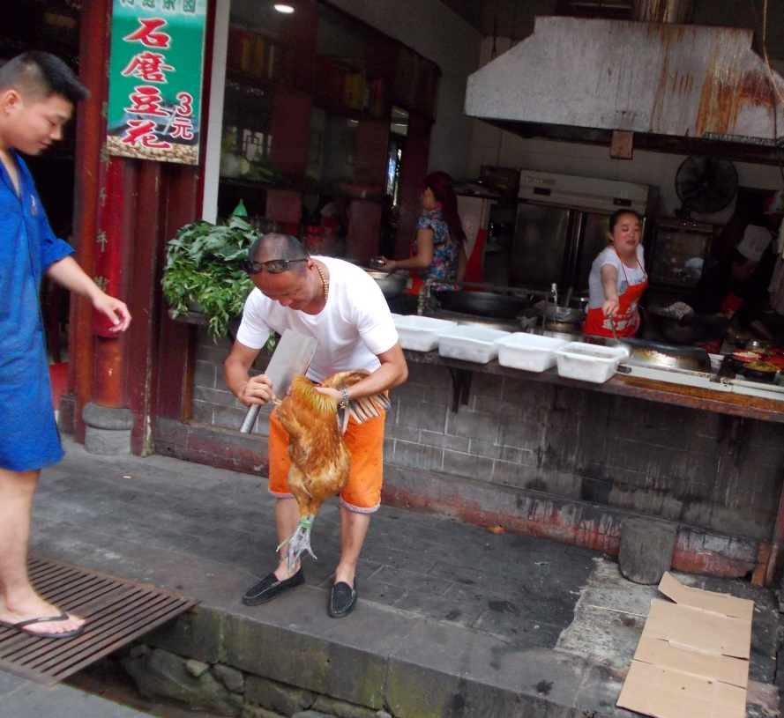
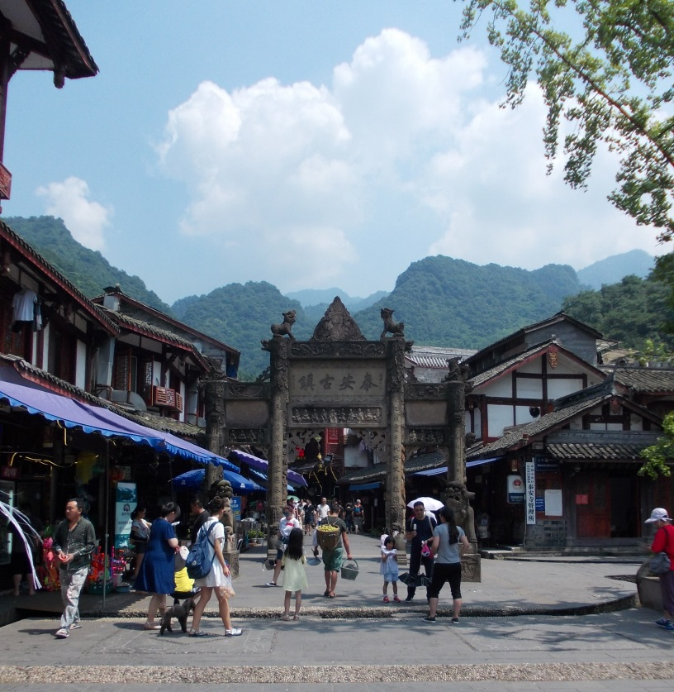
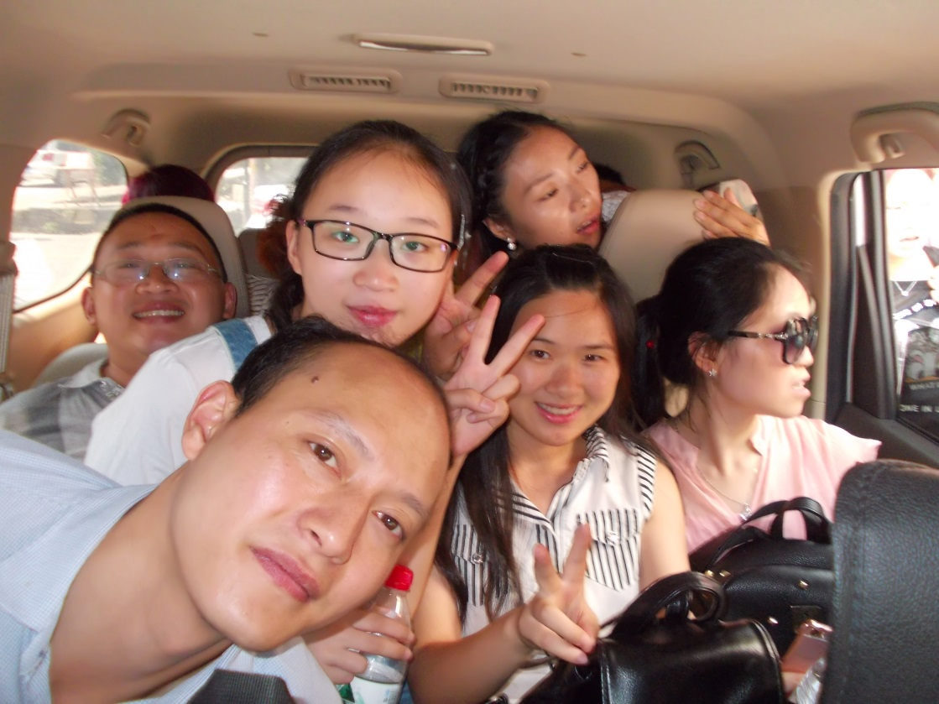
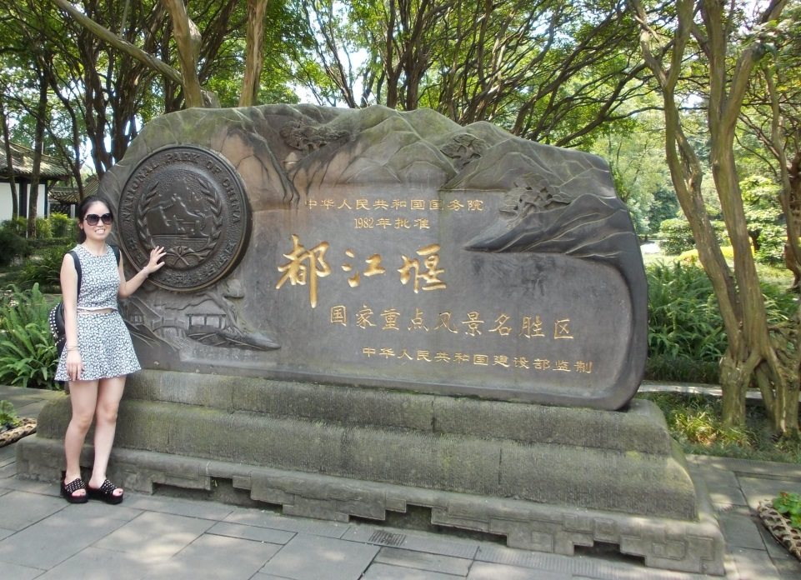
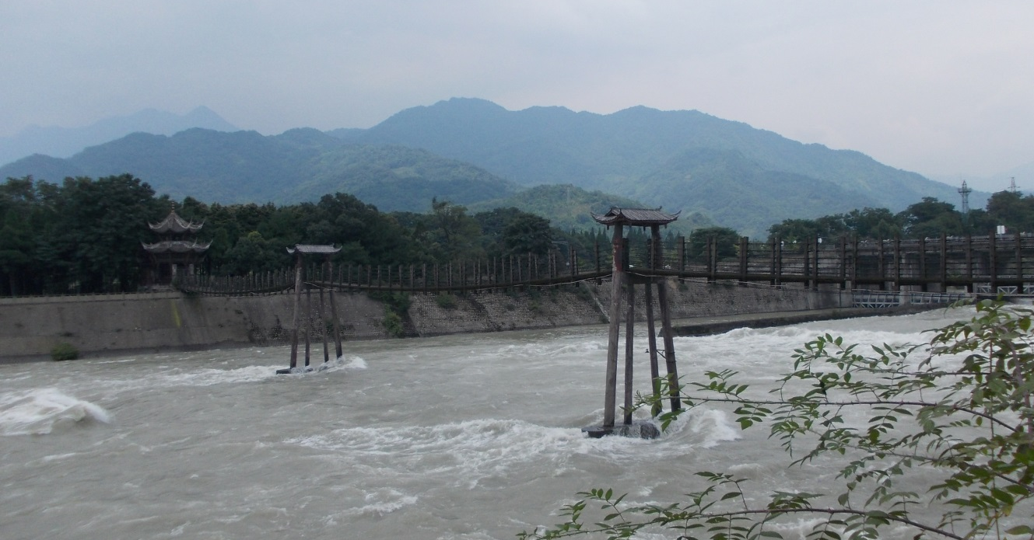

Slide 12
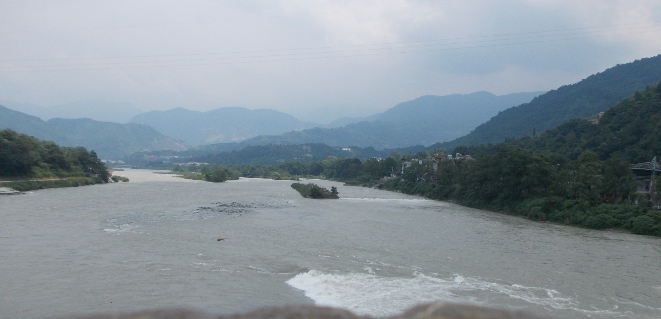
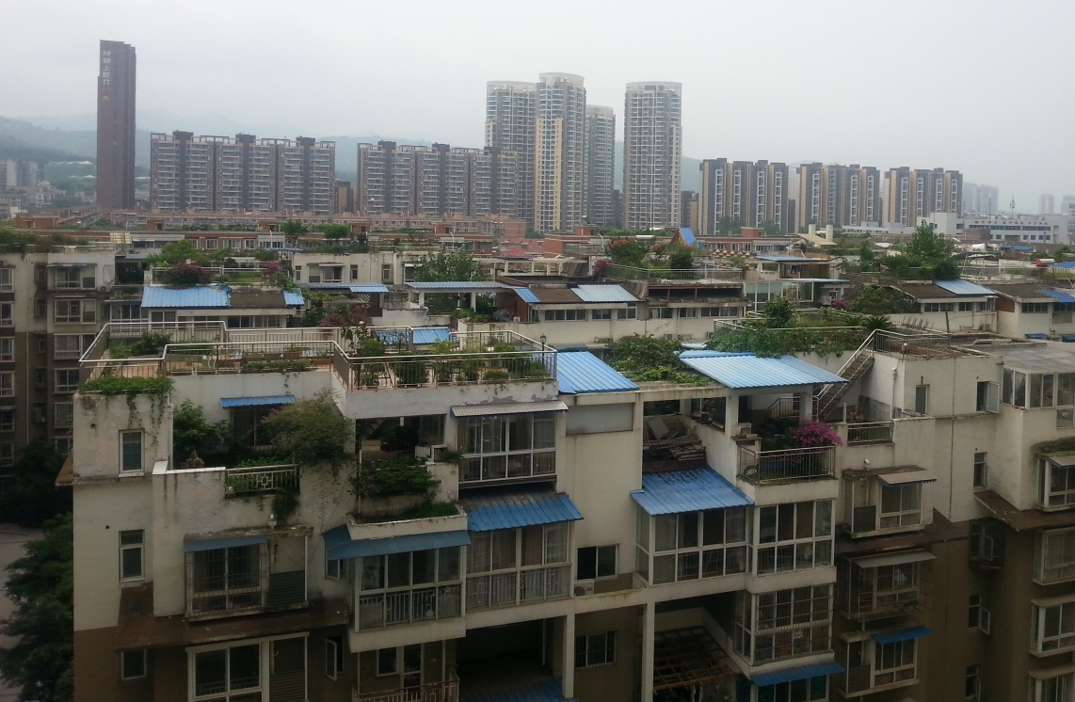

Slide 13
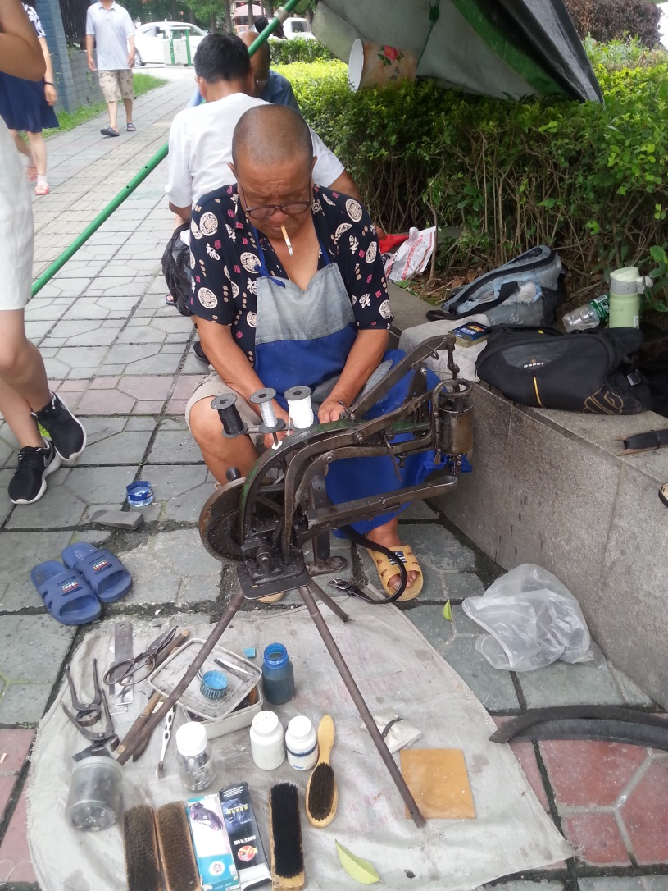
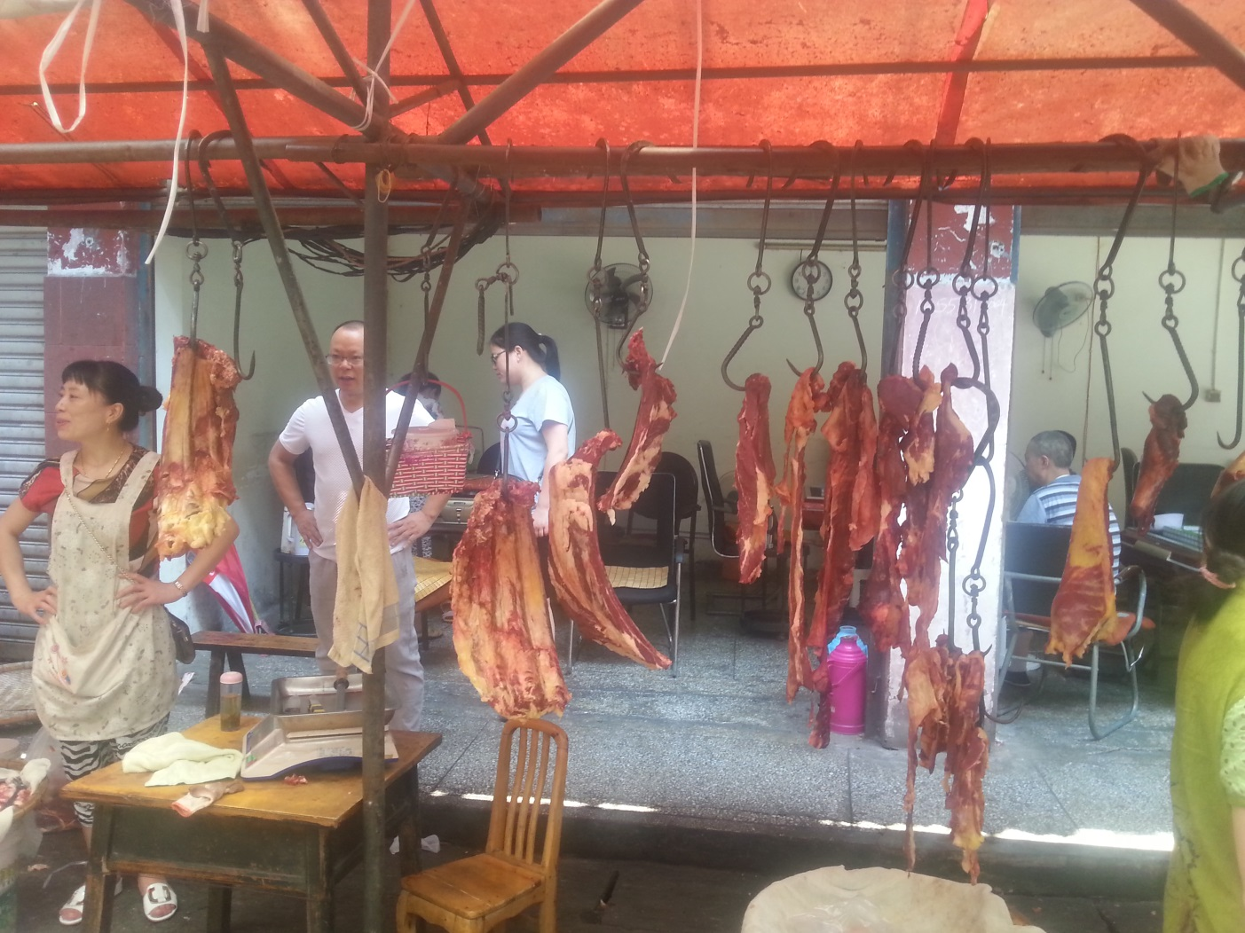

Slide 14
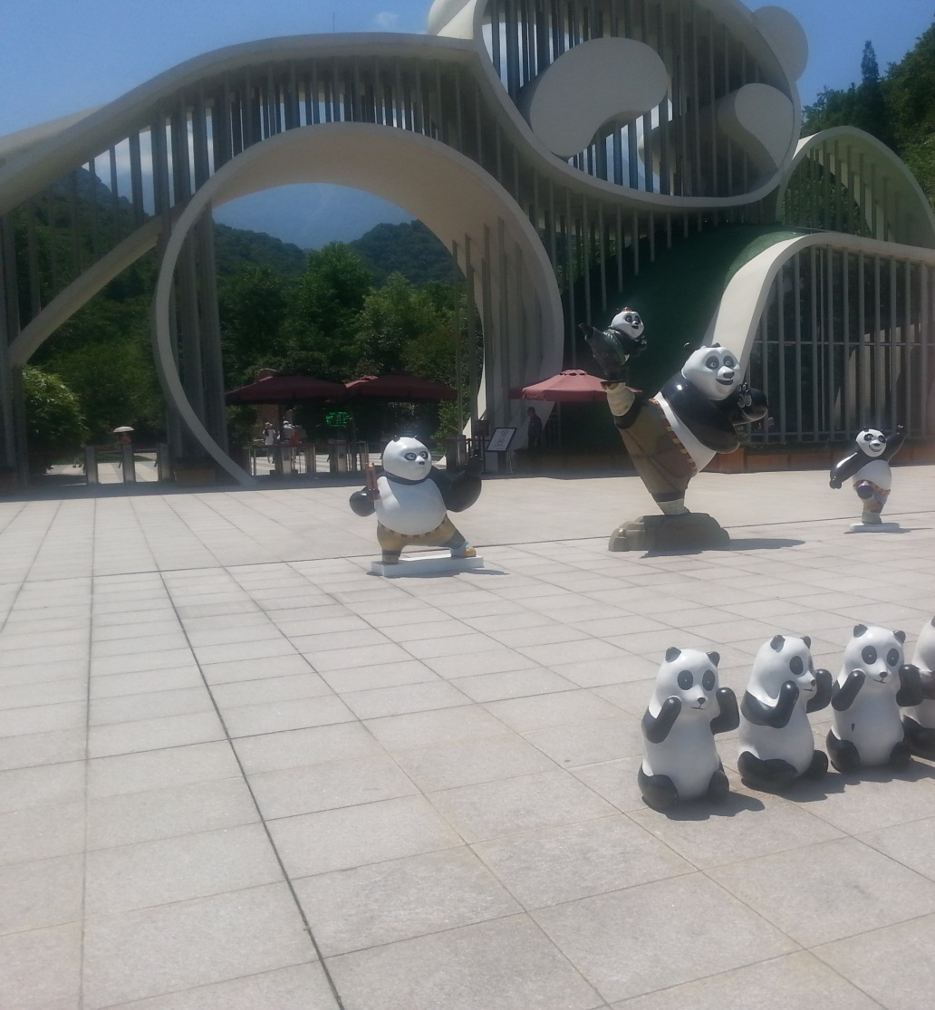
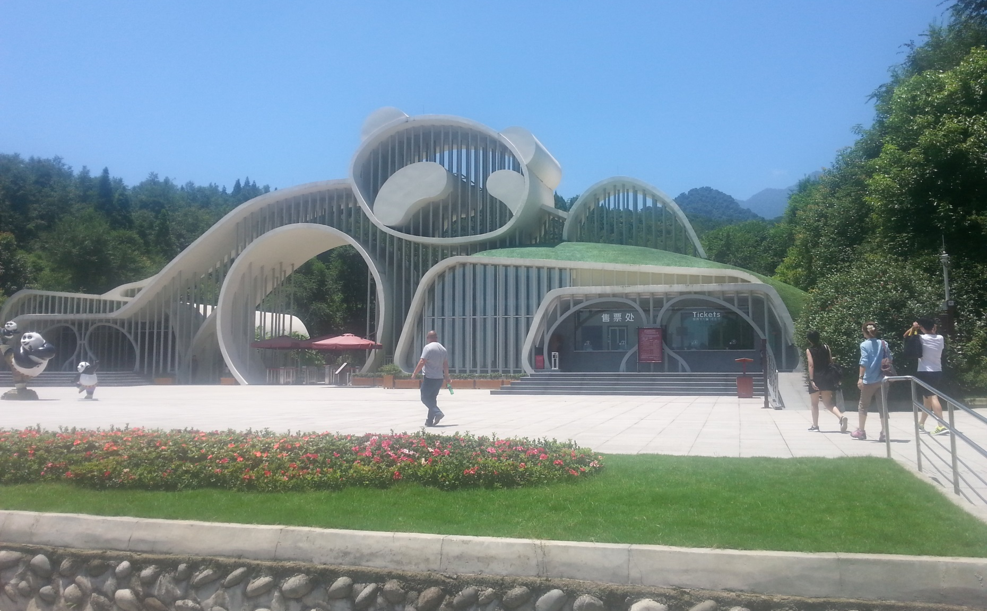
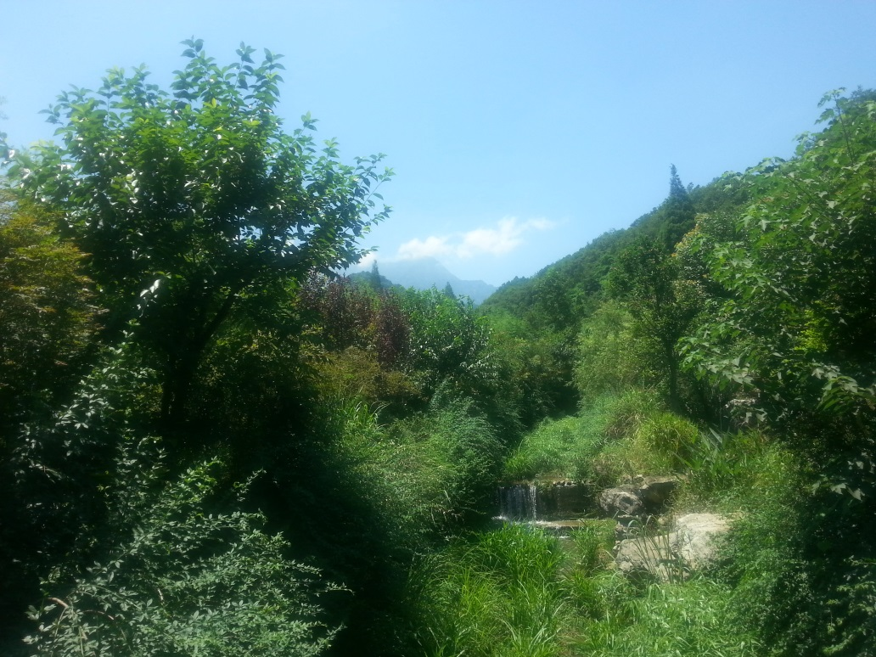

Slide 15
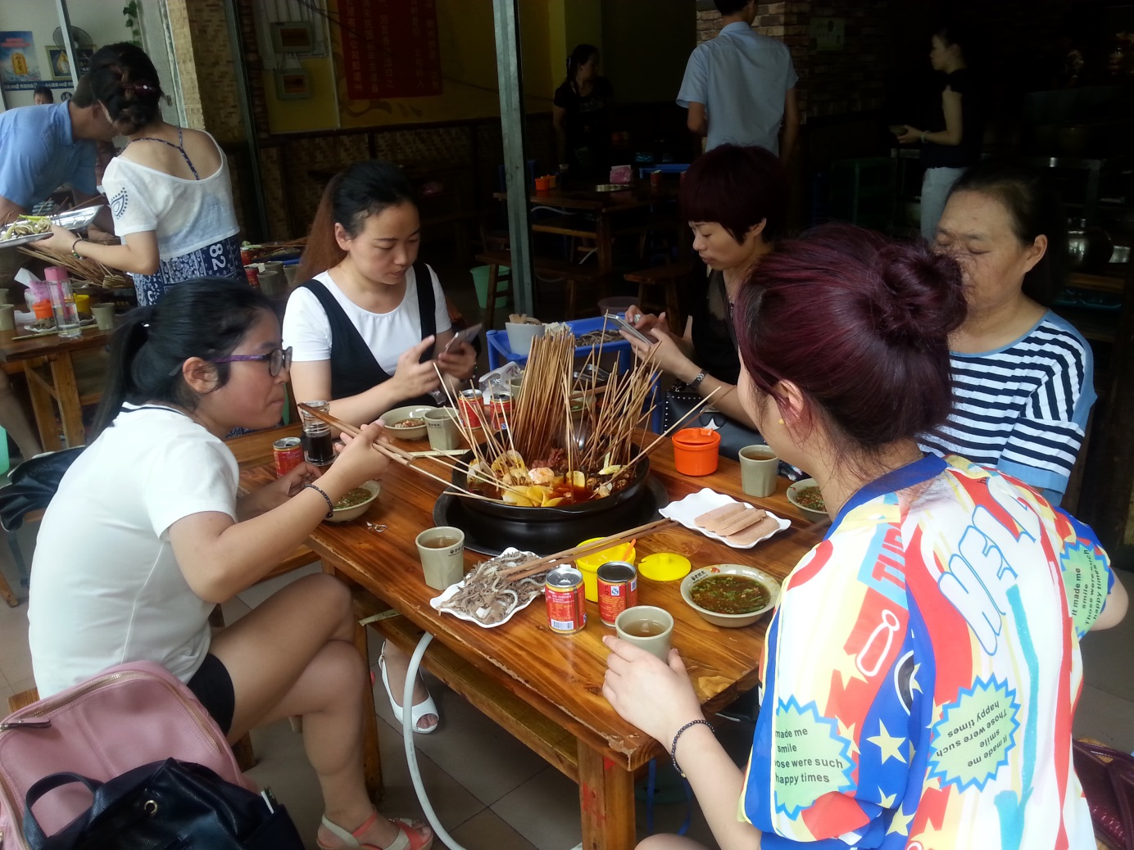
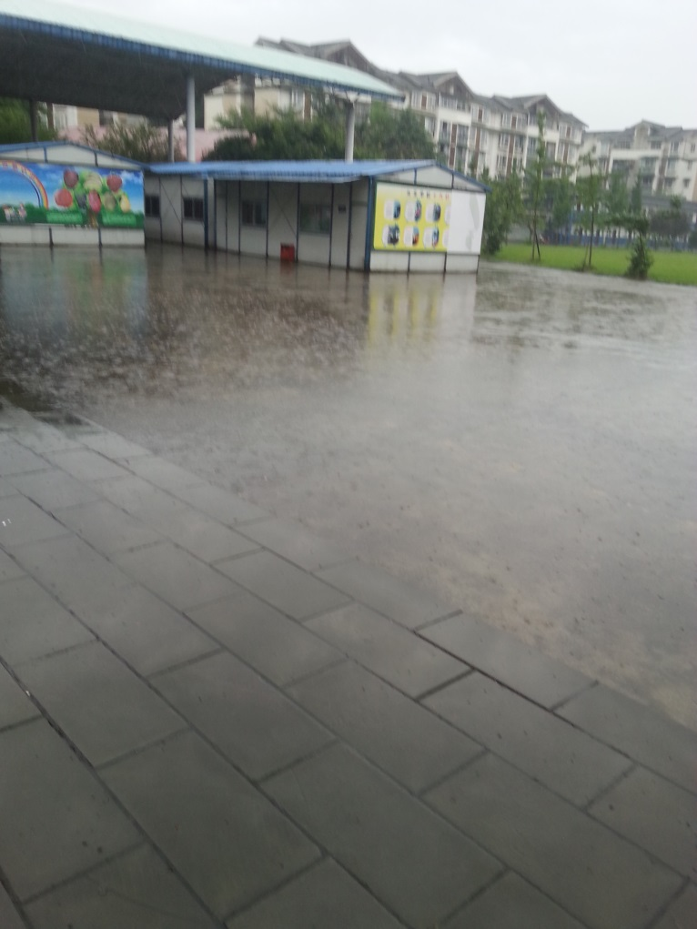
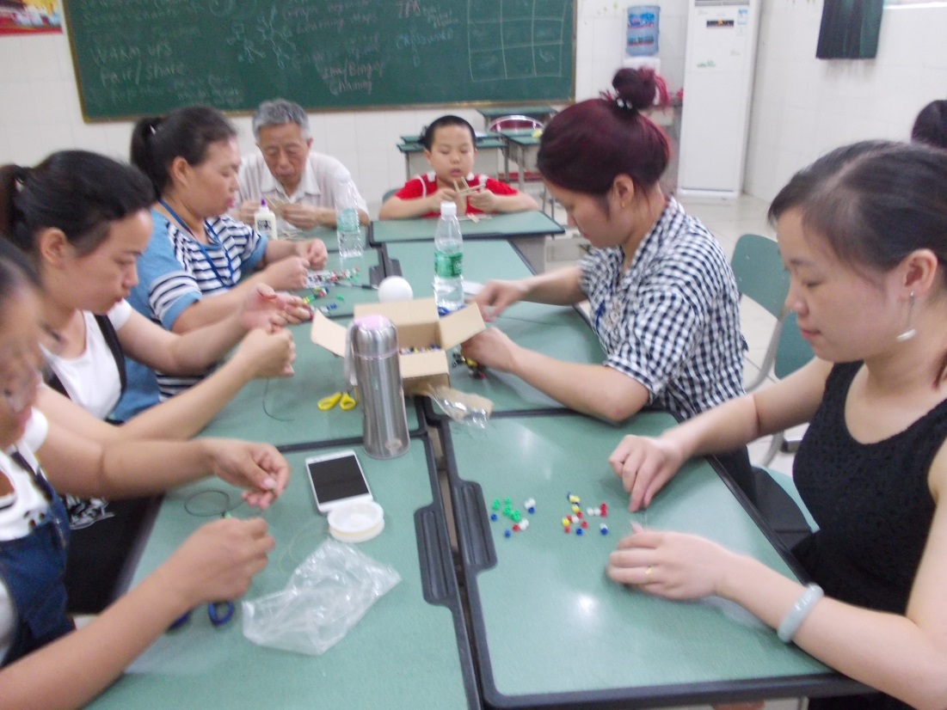
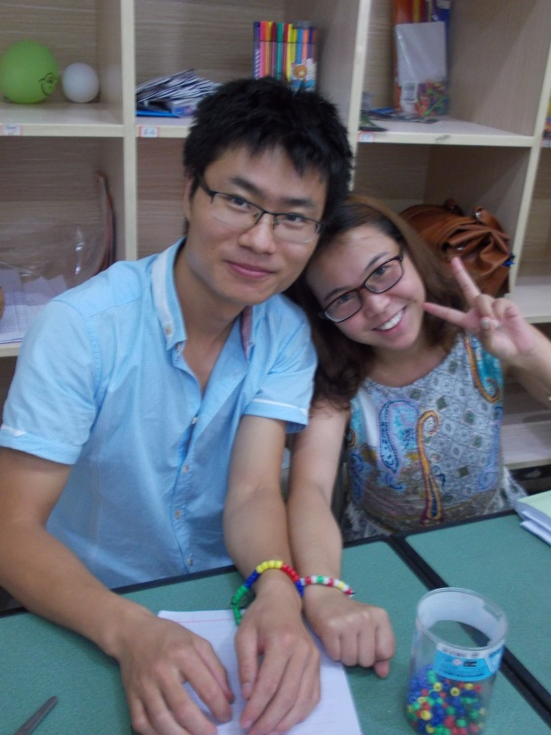
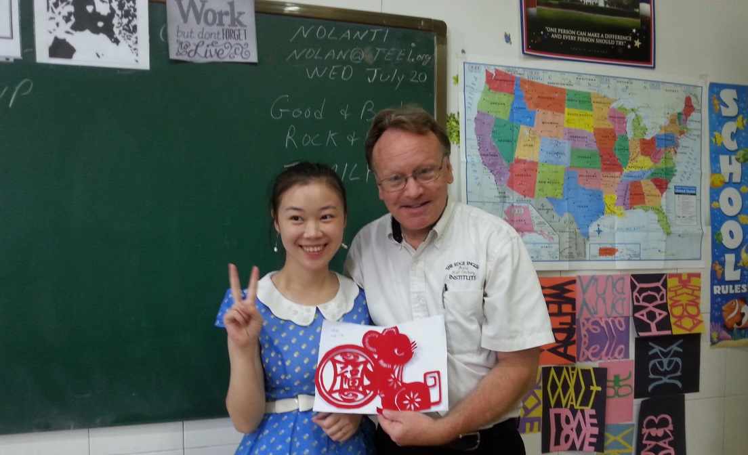

Slide 17
Everyone is Unique and Different!
If you “KNEW” everything, there would be no need to be at the program!
How much do you really know about the universe around you?
You know what you know.
You know what you don’t know.
But, you don’t know what you don’t know?
What do you see?

Slide 18
F.R.O.G.S. (“Change Lesson”)
Because of our experiences today, we will be a different person tomorrow.
Of all the people in the world, we are at this place at this time. WHY?
Frogs, Dragonflies, and Butterflies undergo a major transformation.
Every person has the ability to impact and change someone else!
Friends
Reach
Out
Giving
Support
Tadpoles in a mountain stream

Slide 19
Ojo – De –Dio (Eye of God)
“In God We Trust”
Money, Counting and Numbers

Slide 20
Pinwheels for Peace
You cannot see the wind – you can only see the wind in action.
You cannot see “love” – you can only see “love” in action.

Slide 21
The Many “FACES” of Love

Slide 22
The “Uniqueness” of your name!

Slide 23
The “Puzzle” Activity – How do we all fit together?
In this activity, students write information about themselves on pieces of a puzzle.
The pieces are assembled and the interaction is created.
Another project is the “Name Quilt” or “woven tapestry” but time was limited and all the activities could not be done!

Slide 24
The Guangya Program is a “Teach the Teacher” project, but sometimes we have the opportunity to visit other schools and also teach children.

Slide 25
HOW WILL YOU Be a part of the 2017 Project!
GO!
GIVE (Support others )
SHARE (Tell others)
TEEI.org or NOLAN@TEEI.org

